Slide 1
Final Project: Classification
By: Keegan Henderson

Slide 2

Louisville Stops Data 2022
Activity Division
Activity Beat
Officer Age Range
Officer Gender
Officer Race
Number of Passengers
Was Vehicle Searched
Type of stop
citation control number
Activity results
Activity Time
Activity Location
Reason For Search

Slide 3

Cleaning
Dropping Columns (6)
Get Dummies (on Remaining Columns)
value_counts() function was very useful

Slide 4
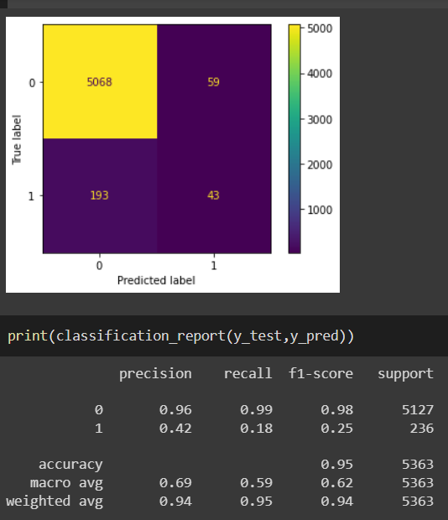
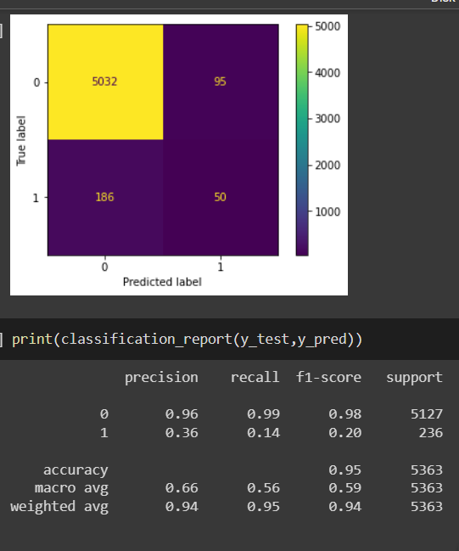
Decision Tree & Random Forest

Slide 5
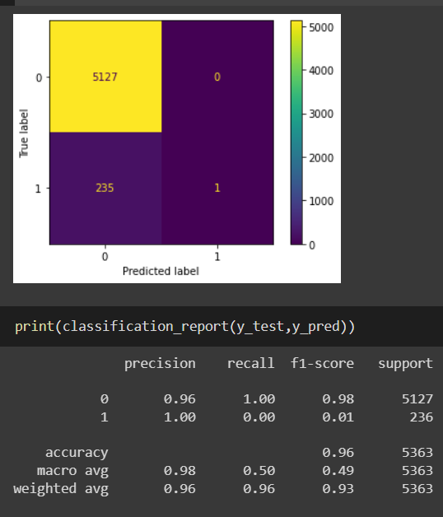
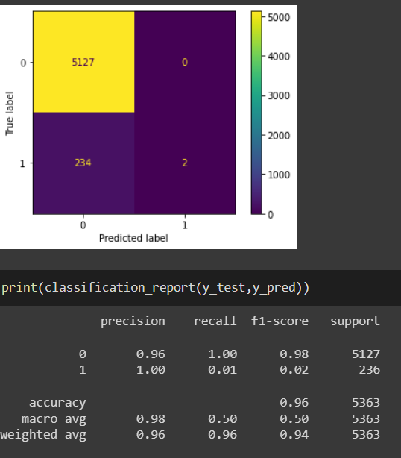
Logistic Regression & SVM Classifier

Slide 6
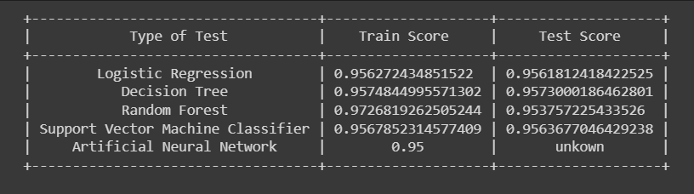
Summary

